Slide 1

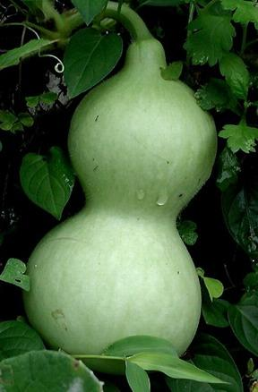
Calabash-android
workshop
Lesson 6: Write additional testing steps.

Slide 2
Additional steps
Location:
../calabash_workspace/features/step_definitions/

Slide 3
Step construction
Then /^I enter "([^\"]*)" into input field number (\d+)$/ do |text, number|
performAction('enter_text_into_numbered_field',text, number)
end
Then - can be alternatively: When, And
"([^\"]*)" - input text argument
(\d+) - input digit argument
text, number - variables store arguments

Slide 4
try … catch block
Example:
Then /^I handle exception$/ do
begin
performAction(“press”,”aaaa”)
rescue -> e
raise “Neither element contain this text”
end
end

Slide 5
Macro function
Example:
Then /^I use macro function$/ do
macro(‘I enter "testText" into input field number 1’)
end

Slide 6
Use Query in step
Example:
When /^I enter "([^\"]*)" to use query function$/ do |text|
elementsArray = query(“TextView”)
unless(elementsArray[0].include? text)
raise “Text not found”
end
end

Slide 7
ListView and Query
Example:
Then /^I use loop$/ do
#query("Button").each { |x| puts x }
query("Button").each do |x|
touch(x)
performAction("go_back")
end
end

Slide 8
Handle listView
Example:
Then /^I handle listView$/ do
result = performAction('get_list_item_text')
response_table = result['bonusInformation']
response_table.each_with_index do | row_data, index |
row_data = JSON.parse( row_data )
response_table[index] = row_data
row = response_table[index]
firstColumn = row[“first_column”]
secondColumn = row[“second_column”]
end
end

